Slide 1

Raspberry Pi GPIO Overview
OpenWest 2014
Gaudeon, Alisa Green, Image
Travis Chase
gaudeon@cpan.org
https://github.com/gaudeon/rpi_gpio_overview

Slide 2
Once upon a time...
I wanted to be a magician's electrician's apprentice.

Slide 3
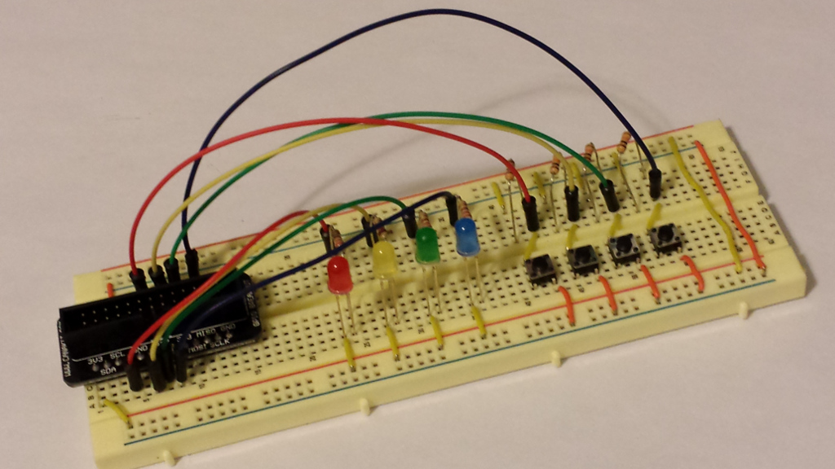
And Now...
I am recovering a dormant hobby with the Raspberry Pi
SimonPi, Travis Chase, Photograph

Slide 4
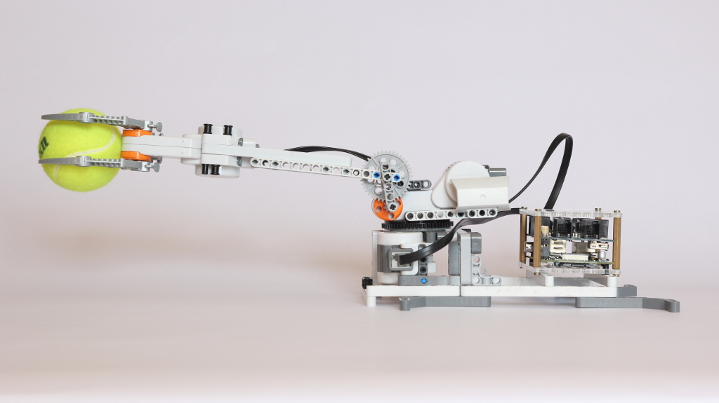
BrickPi
BrickPi Arm, Dexter Industries, Retrieved from http://www.dexterindustries.com/BrickPi/wp-content/uploads/2013/04/IMG_2237.jpg

Slide 5
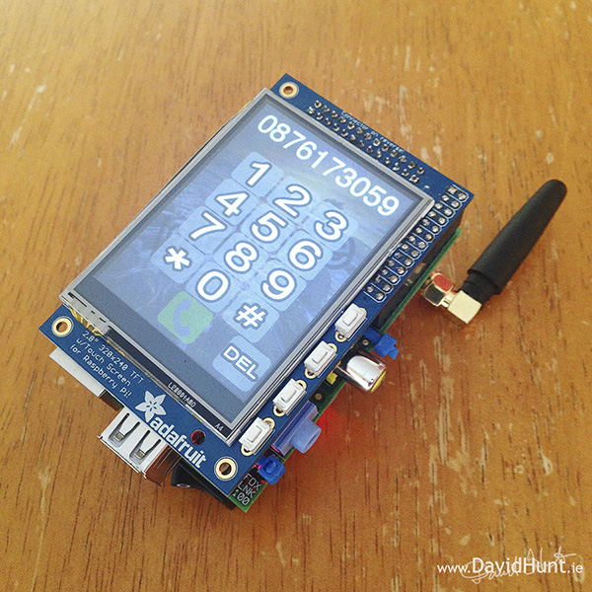
PiPhone
PiPhone, David Hunt, Retireved from http://www.davidhunt.ie/wp-content/uploads/2014/04/IMG_0872d.jpg

Slide 6
SimonPi
SimonPi, Travis Chase, Photograph

Slide 7
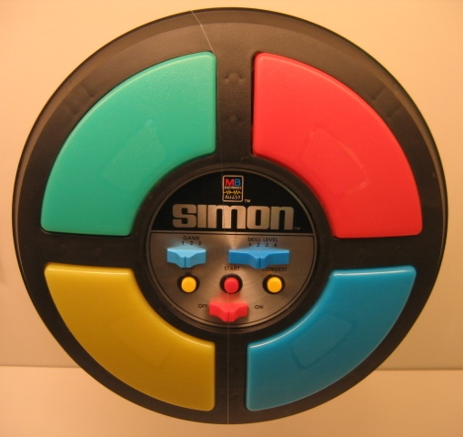
Simon
Original Simon, Wikipedia (Hempdiddy), Retrieved from http://en.wikipedia.org/wiki/File:OriginalSimon.jpg

Slide 8
Don't Panic...
Theory > Hardware > Software

Slide 9
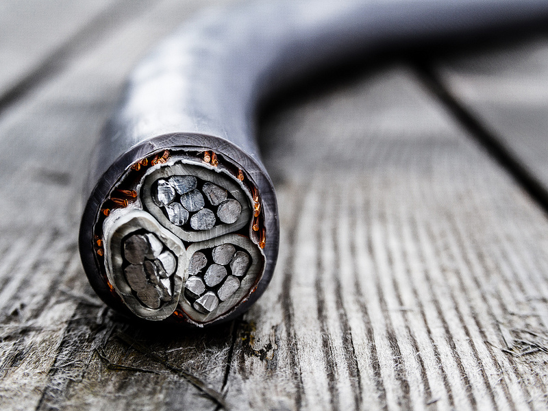
Current
The flow of electrical charge. Measured in amperes (A).
cable, anders hoff, retrieved from https://flic.kr/p/cuwhqs

Slide 10
Direct Current
Direct Current is the flow of electrical charge that only ever moves in one direction along the conductor.
cable, anders hoff, retrieved from https://flic.kr/p/cuwhqs

Slide 11

Voltage
The difference in potential between two charged bodies.
Measured in volts (V).
MD Voltage, Halcyon-of-Time (aka Alex),
Retrieved from http://halcyon-of-time.deviantart.com/art/Mountain-dew-voltage-169078456

Slide 12
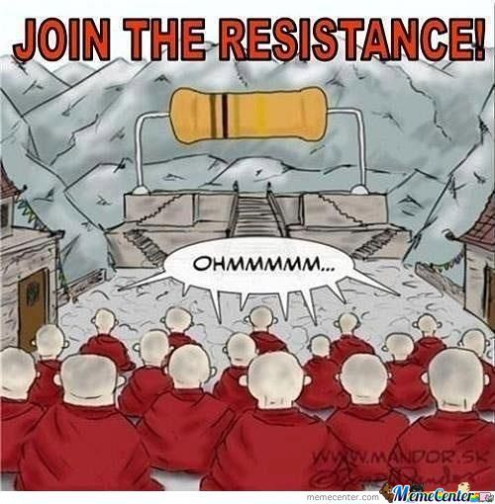
Resistance
Opposition to current flow. Measured in ohms (Ω).
Resistance, krishmar4, Retrieved from http://www.memecenter.com/fun/930534/resistance

Slide 13

Ohm's Law
Ohm's law is a foundational formula of circuit analysis.
V = IR
I = V / R
R = V / I
Ohm's Law, Wikipedia,
Retrieved from http://upload.wikimedia.org/wikipedia/commons/d/de/OhmsLaw.svg
Notes:
sometimes E is used instead of V...

Slide 14


Types of Circuits
A closed loop of electrical elements around which current can flow when the circuit is closed.
Series
Parallel
Resistors in Parallel and Series, Wikipedia (Omegatron),
Retrieved from http://en.wikipedia.org/wiki/File:Resistors_in_parallel.svg
nd http://en.wikipedia.org/wiki/File:Resistors_in_series.svg

Slide 15
Short Circuit
An unintended or accidental circuit between two points.

Slide 16
Kirchoff's voltage law (KVL)
The directed sum of voltage around any closed network is zero.

Slide 17
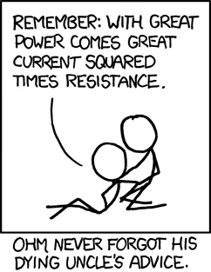
Joule Heating in Direct Current
Instantaneous rate at which work is being done.
P = IV
P = V²/R
P = I²R
Ohm, Randal Munroe, Retrieved from https://xkcd.com/643/

Slide 18

Safety - Shock
Even currents as low as 5mA can be dangerous!
Though, you can feel a currents as low as 1mA.
Don't work on your projects while they are live.
danger! (Modified), Joel Kramer, Retrieved from https://flic.kr/p/4X1VHh

Slide 19
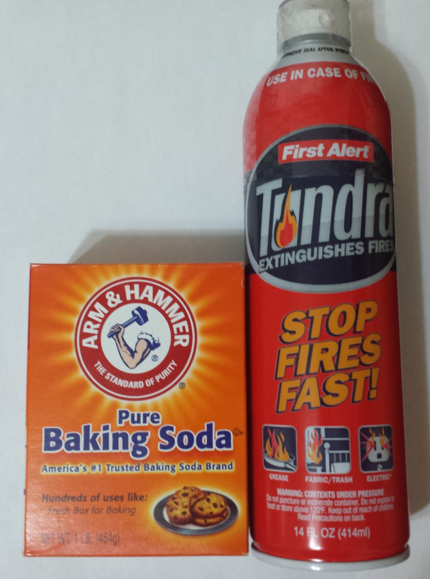
Safety - Electrical Fires
Use a Class C Extinguisher or Baking Soda. Never water!
baking soda and extinguisher, Travis Chase, Photograph

Slide 20
Hardware
1 x Raspberry Pi Model B
1 x 8 GB SD Card
1 x Micro USB PowerSupply
Peripherals (Keyboard, Montor, etc)
1 x WiFi Dongle
1 x Pi Cobbler
1 x GPIO Ribbon Cable 2x13
1 x Breadboard
Wires (28 - Various sizes)
4 x 220 ohm resistors
4 x 10k ohm resistors
4 x Momentary (Tactile) switches
1 x Red LED
1 x Yellow LED
1 x Green LED
1 x Blue LED

Slide 21
Starter Kits
You could also get many of the components in a starter kit.

Slide 22
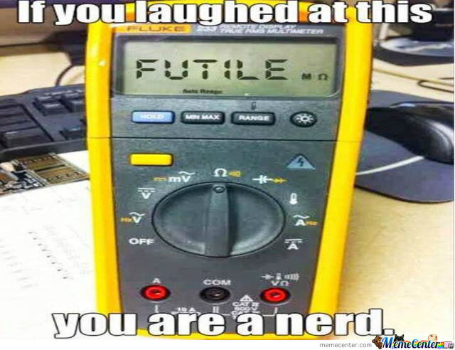
Other equipment
Needle Nosed Pliers
Digital Multimeter
Resistance is Futile, Author Unknown, Retrieved from http://memecenter.com

Slide 23
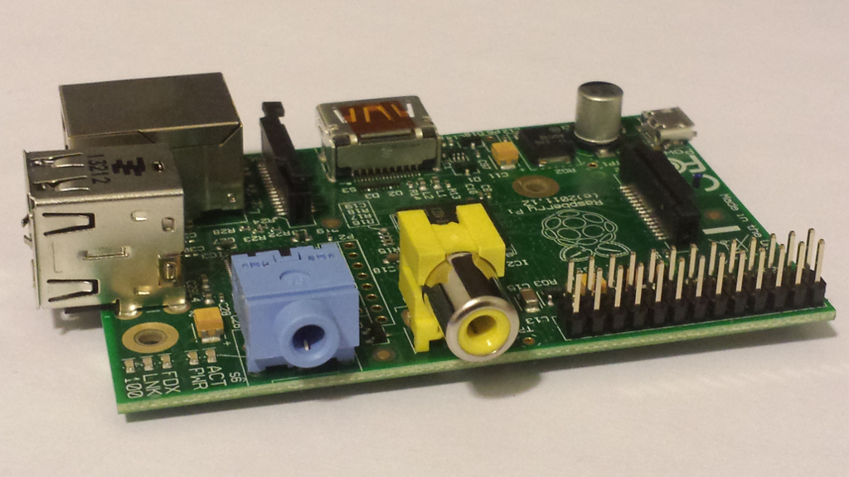
Raspberry Pi GPIO
rpi, Travis Chase, Photograph

Slide 24
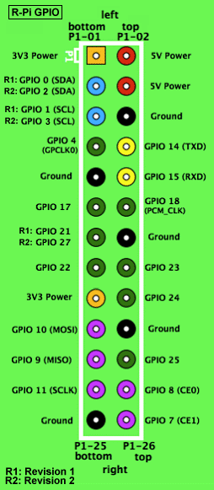
GPIO Pins
26 pins
17 are programmable
2 are 3V3
2 are 5V
5 are ground
gpios, Jbeale, Retrieved from http://elinux.org/File:GPIOs.png

Slide 25
Pin Logic - Inputs
Pins set as input will register as high (1) when their voltage is within the top 10% range of 3V3.
They will register as low (0) when their voltage is within the bottom 10% range of 3V3.
Otherwise it's considered floating.
Notes:
Electricity may be analog but pin logic is digital.

Slide 26
Pin Logic - Outputs
Pins set as ouput will have a voltage of 3V3 when set to high (1).
They will have a voltages of 0V when set to low (0).

Slide 27
GPIO Safety
Be wary of the 5V output pins!

Slide 28
GPIO Safety
Don't connect exposed wires directly to your Raspberry Pi GPIO.
: (

Slide 29
GPIO Safety
Beware of Static Electricity.

Slide 30
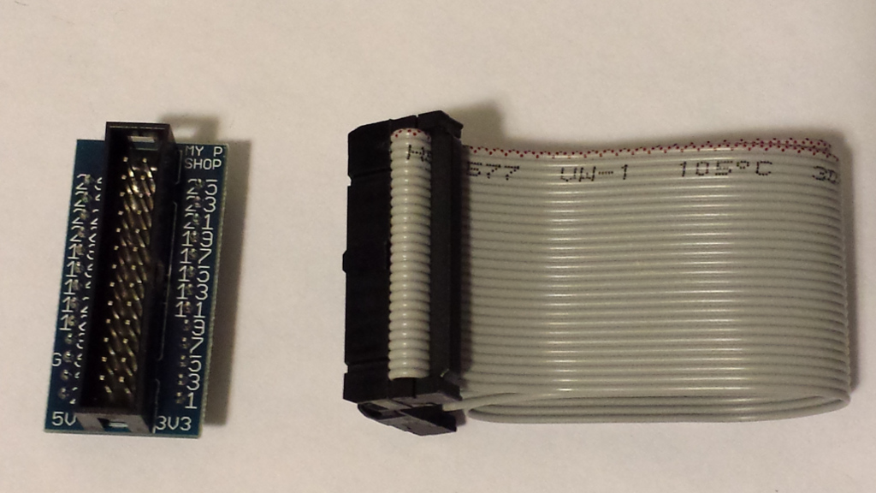
Pi Cobbler
pi cobbler, Travis Chase, Photograph

Slide 31
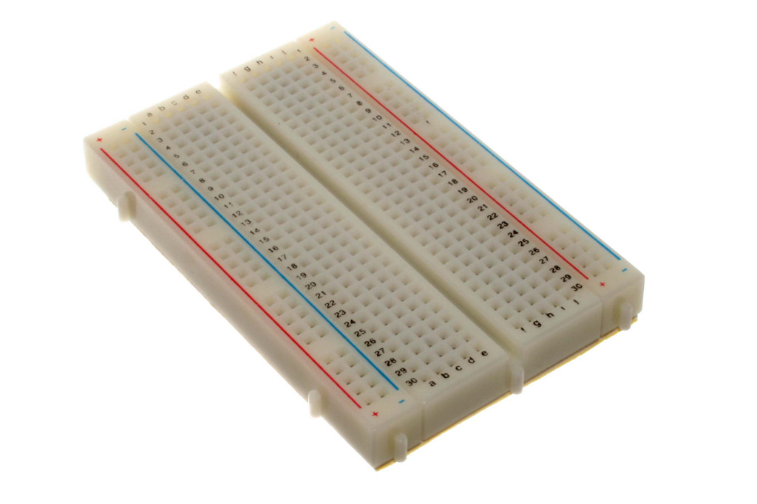
Breadboard
400 points breadboard, Wikipedia (oomlout) Retrieved from http://en.wikipedia.org/wiki/File:400_points_breadboard.jpg

Slide 32
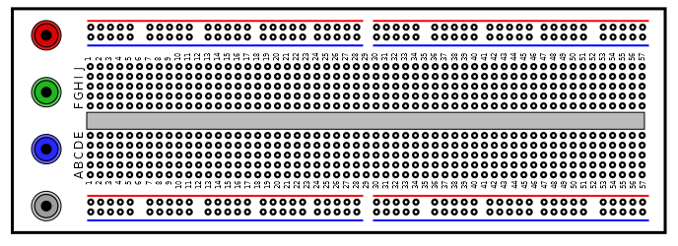
Breadboard
Breadboards have conducting strips that you can plug voltage sources, electrical components and wiring into.
breadboard, WIkipedia (jjbeard), Retrieved from http://en.wikipedia.org/wiki/File:Breadboard.svg

Slide 33
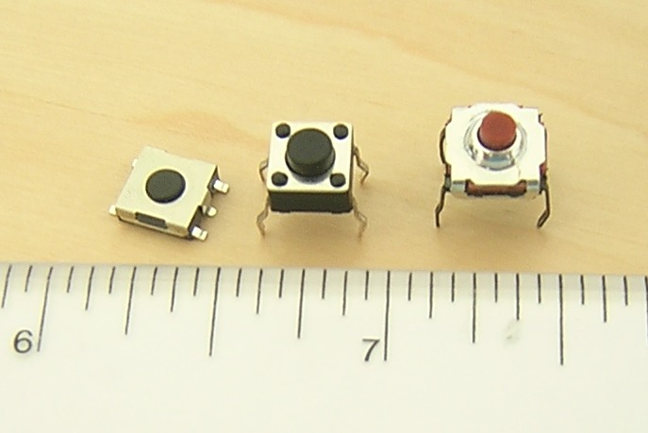
Momentary (Tactile) Switches
Tactile Switches, Wikipedia (Scwerllguy), Retrieved from http://en.wikipedia.org/wiki/File:Tactile_switches.jpg

Slide 34
Momentary (Tactile) Switches
Use needle nosed pliers to straighten the pins.

Slide 35
Momentary (Tactile) Switches
A digital multimeter with a continuity setting can help find the connected pins.

Slide 36
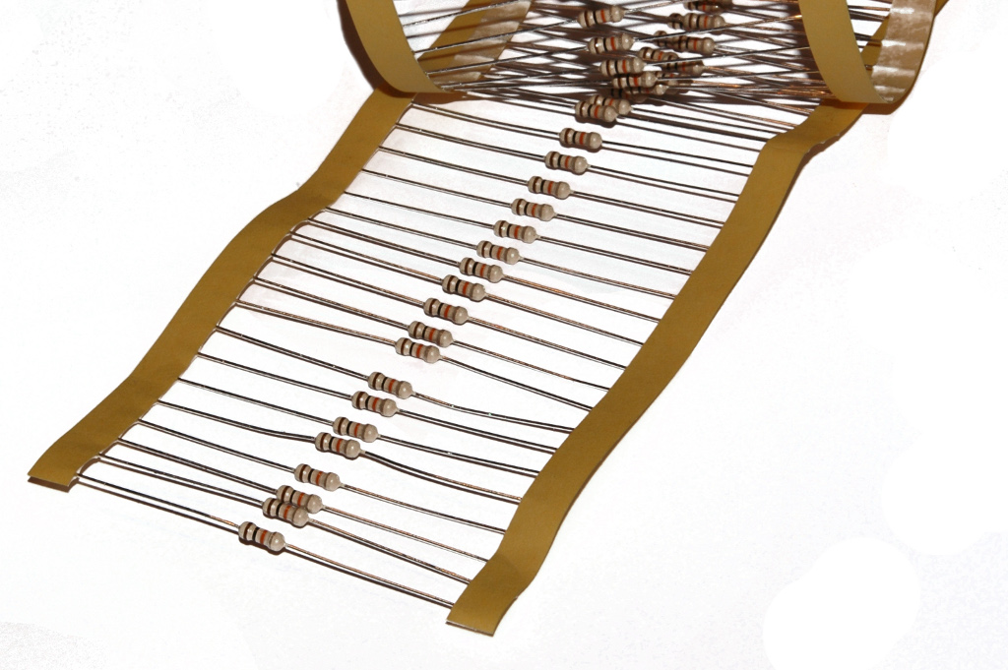
Resistors
Resistors on tape, Wikipedia (Inductiveload), Retrieved from http://en.wikipedia.org/wiki/File:Resistors_on_tape.jpg

Slide 37
Resistors
In Series: R_{t} = R₁ + R₂ + … + R_{n}
In Parallel: 1 / R_{t} = 1 / R₁ + 1 / R₂ + … + 1 / R_{n}
Series
Parallel
Resistors in Parallel and Series, Wikipedia (Omegatron),
Retrieved from http://en.wikipedia.org/wiki/File:Resistors_in_parallel.svg
and http://en.wikipedia.org/wiki/File:Resistors_in_series.svg

Slide 38
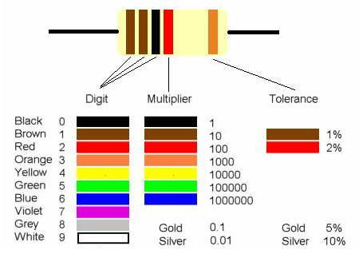
Resistors
Resistor color codes, Wanka7a,
Retrieved from http://www.instructables.com/id/How-to-read-color-codes-from-resistors-1/

Slide 39
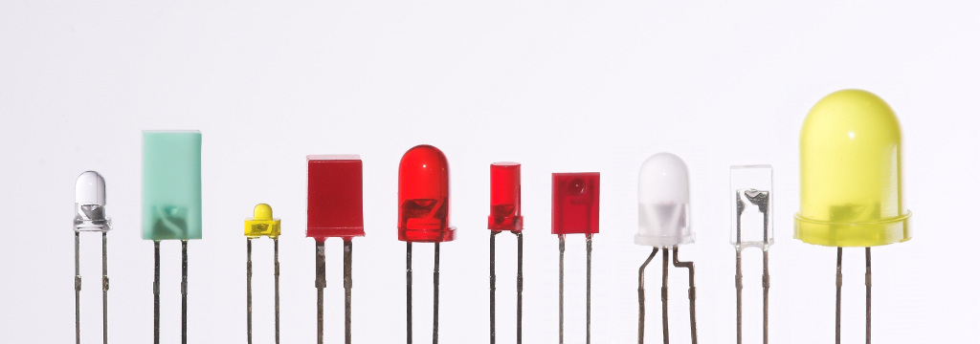
Light Emitting Diodes (LEDs)
leds, Wikipedia (afrank99), Retrieved from http://en.wikipedia.org/wiki/File:Verschiedene_LEDs.jpg

Slide 40
Light Emitting Diodes (LEDs)
For single color LEDs, conventionally, the longer pin is the anode (+).

Slide 41
Light Emitting Diodes (LEDs)
A digital multimeter with a diode setting can help you find the voltage drop.

Slide 42
Light Emitting Diodes (LEDs)
Use a resistor to prevent burning out your LED.
R = (V_{s –} V_{fv}) / I_{max}
Notes:
My FV for Red LED – 1.8V so at least 75 ohm resistor needed
My FV for Yellow LED – 1.9V so at least 70 ohm resistor needed
My FV for Green LED – 1.9V so at least 70 ohm resistor needed
My FV for Blue LED – 2.7V so at least 30 ohm resistor needed
So I probably could have used a 100ohm resistor for everything. I even could have just used a 50 ohm resistor for blue but I was being a little extra cautious so I used 220 ohm resistors.

Slide 43

Circuit Diagrams
Circuit Elements, Wikipedia (DnetSvg), Retrieved from http://en.wikipedia.org/wiki/File:Circuit_elements.svg

Slide 44
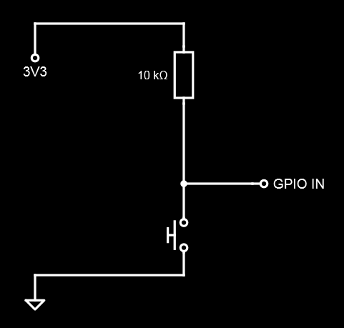
Button Input
Button Input, Travis Chase, Image
Notes:
Pullup Resistor - When connecting a GPIO input pin to a voltage source use a resistor to avoid a short circuit when the circuit is closed. That resistor is conventionally called a pullup resistor.

Slide 45
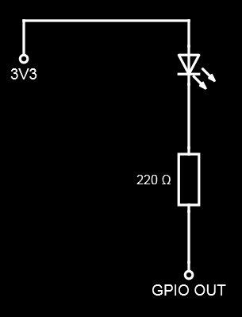
LED Output
LED Output, Travis Chase, Image
Notes:
Pulldown Resistor - When connecting a GPIO input pin to ground use a resistor to avoid a short circuit when the circuit is closed. That resistor is conventionally called a pulldown resistor.

Slide 46
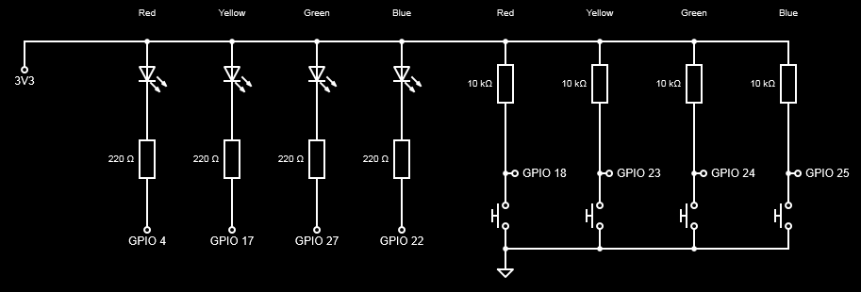
SimonPi
SimonPi, Travis Chase, Image

Slide 47
SimonPi
SimonPi, Travis Chase, Photograph

Slide 48
Python – RPi.GPIO
Download tarball of the Python Package from http://pypi.python.org/pypi/RPi.GPIO
tar -xzvf <tarball>
cd <extracted directory>
sudo python setup.py install

Slide 49
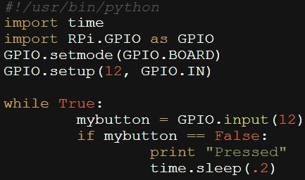
button_test.py
Python button test, Travis Chase, Image

Slide 50
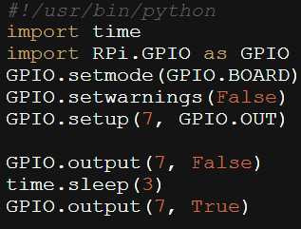
led_test.py
Python led test, Travis Chase, Image

Slide 51
PERL - HiPi
wget http://raspberry.znix.com/hipifiles/hipi-install
./hipi-install
OR you could install from CPAN.

Slide 52
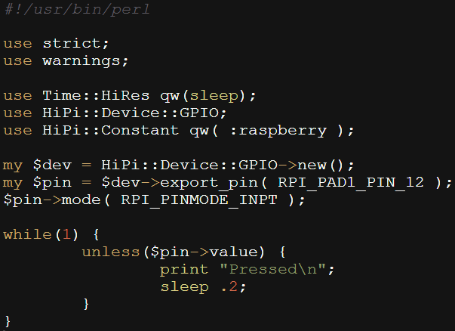
button_test.pl
Perl button test, Travis Chase, Image

Slide 53
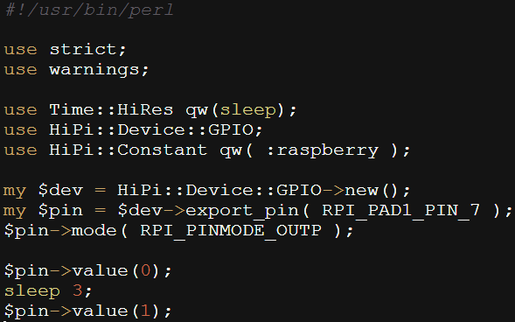
led_test.pl
Perl led test, Travis Chase, Image

Slide 54
SimonPi Demo?

Slide 55
References
Ben Croston, GPIO Python Package,
Online. Available: http://sourceforge.net/p/raspberry-gpio-python/wiki/Home/
Charles Platt (2013), Encyclopedia of Electronic Components Volume 1,
MakerMedia, Sebastopol, CA
Charles Platt (2009), Make: Electronics,
MakerMedia, Sebastopol, CA
Darren Grant, In Control, The MagPi Issue 2 - June 2012,
Online. Available: http://www.themagpi.com/issue/issue-2/article/in-control/
Darren Grant, In Control: GPIO Outputs, The MagPi Issue 2 - June 2012,
Online. Available: http://www.themagpi.com/issue/issue-3/article/in-control-gpio-outputs/
Earl Boysen and Harry Kybett (2012), Complete Electronics Self-Teaching Guide with Projects,
John wiley & Sons, Inc., Indianapolis IN
Embedded Linux Wiki, RPi low level peripherals,
Online. Available: http://elinux.org/RPi_Low-level_peripherals

Slide 56
References
Gordon Henderson (Drogon), Wiring Pi,
Online. Available: http://wiringpi.com/
Mark Dootson, HiPi Perl Modules,
Online. Available: http://raspberrypi.znix.com/hipidocs/
Research & Education Association (2002), Basic Electricity,
Research & Education Association, Piscataway, NJ
Simon Monk (2013), Hacking Electronics: An illustrate DIY guide for makers and hobbyists
McGraw Hill Education, New York
Wikipedia, Circuit Diagram,
Online. Available: http://en.wikipedia.org/wiki/Circuit_diagram
Wikipedia, Circuit Theory,
Online. Available: http://en.wikipedia.org/wiki/Circuit_theory
Wikipedia, Electrical resistance and conductance,
Online. Available: http://en.wikipedia.org/wiki/Electrical_resistance

Slide 57
References
Wikipedia, Electromotive force,
Online. Available: http://en.wikipedia.org/wiki/Electromotive_force
Wikipedia, Electronic Symbol,
Online. Available: http://en.wikipedia.org/wiki/Electronic_symbol
Wikipedia, Ground (electricity),
Online. Available: http://en.wikipedia.org/wiki/Ground_(electricity)
Wikipedia, Joule heating,
Online. Available: http://en.wikipedia.org/wiki/Joule_heating
Wikipedia, Light emitting diode,
Online. Available: http://en.wikipedia.org/wiki/Light-emitting_diode
Wikipedia, Ohm's law,
Online. Available: http://en.wikipedia.org/wiki/Ohms_law
Wikipedia, Pull-up Resistor,
Online. Available: http://en.wikipedia.org/wiki/Pull-up_resistor

Slide 58
References
Wikipedia, Resistance,
Online. Available: http://en.wikipedia.org/wiki/Resistance
Wikipedia, Resistor,
Online. Available: http://en.wikipedia.org/wiki/Resistor
Wikipedia, Semiconductor,
Online. Available: http://en.wikipedia.org/wiki/Semiconductor
Wikipedia, Short Circuit,
Online. Available: http://en.wikipedia.org/wiki/Short_circuit
Wikipedia, Switch,
Online. Available: http://en.wikipedia.org/wiki/Switch

Slide 59
Images
400 points breadboard, Wikipedia (oomlout) Retrieved from http://en.wikipedia.org/wiki/File:400_points_breadboard.jpg
Baking soda and extinguisher, Travis Chase, Photograph
BrickPi Arm, Dexter Industries, Retrieved from http://www.dexterindustries.com/BrickPi/wp-content/uploads/2013/04/IMG_2237.jpg
Breadboard, WIkipedia (jjbeard), Retrieved from http://en.wikipedia.org/wiki/File:Breadboard.svg
Button Input, Travis Chase, Image
Cable, anders hoff, Retrieved from https://flic.kr/p/cuwhqs
Circuit Elements, Wikipedia (DnetSvg), Retrieved from http://en.wikipedia.org/wiki/File:Circuit_elements.svg
Danger! (Modified), Joel Kramer, Retrieved from https://flic.kr/p/4X1VHh
Gaudeon, Alisa Green, Image
Gpios, Jbeale, Retrieved from http://elinux.org/File:GPIOs.png

Slide 60
Images
LED Output, Travis Chase, Image
MD Voltage, Halcyon-of-Time (aka Alex), Retrieved from http://halcyon-of-time.deviantart.com/art/Mountain-dew-voltage-169078456
Ohm, Randal Munroe, Retrieved from https://xkcd.com/643/ors_in_series.svg
Ohm's Law, Wikipedia, Retrieved from http://upload.wikimedia.org/wikipedia/commons/d/de/OhmsLaw.svg
Original Simon, Wikipedia (Hempdiddy), Retrieved from http://en.wikipedia.org/wiki/File:OriginalSimon.jpg
Perl button test, Travis Chase, Image
Perl led test, Travis Chase, Image
PiPhone, David Hunt, Retireved from http://www.davidhunt.ie/wp-content/uploads/2014/04/IMG_0872d.jpg
Python button test, Travis Chase, Image
Python led test, Travis Chase, Image

Slide 61
Images
Resistance, krishmar4, Retrieved from http://www.memecenter.com/fun/930534/resistance
Resistance is Futile, Author Unknown, Retrieved from http://memecenter.com
Resistor color codes, Wanka7a, Retrieved from http://www.instructables.com/id/How-to-read-color-codes-from-resistors-1/
Resistors in parallel, Wikipedia (Omegatron), Retrieved from http://en.wikipedia.org/wiki/File:Resistors_in_parallel.svg
Resistors in series, Wikipedia (Omegatron), Retrieved from http://en.wikipedia.org/wiki/File:Resistors_in_series.svg
Resistors on tape, Wikipedia (Inductiveload), Retrieved from http://en.wikipedia.org/wiki/File:Resistors_on_tape.jpg
Rpi, Travis Chase, Photograph
SimonPi, Travis Chase, Image
SimonPi, Travis Chase, Photograph
Tactile Switchs, Wikipedia (Scwerllguy), Retrieved from http://en.wikipedia.org/wiki/File:Tactile_switches.jpg

Slide 62
Easy Questions?
Gaudeon, Alisa Green, Image
Travis Chase
gaudeon@cpan.org
https://github.com/gaudeon/rpi_gpio_overview

